Slide 1
Chef and Chef Delivery
Thomas Petchel
Technical Content Lead

Slide 2
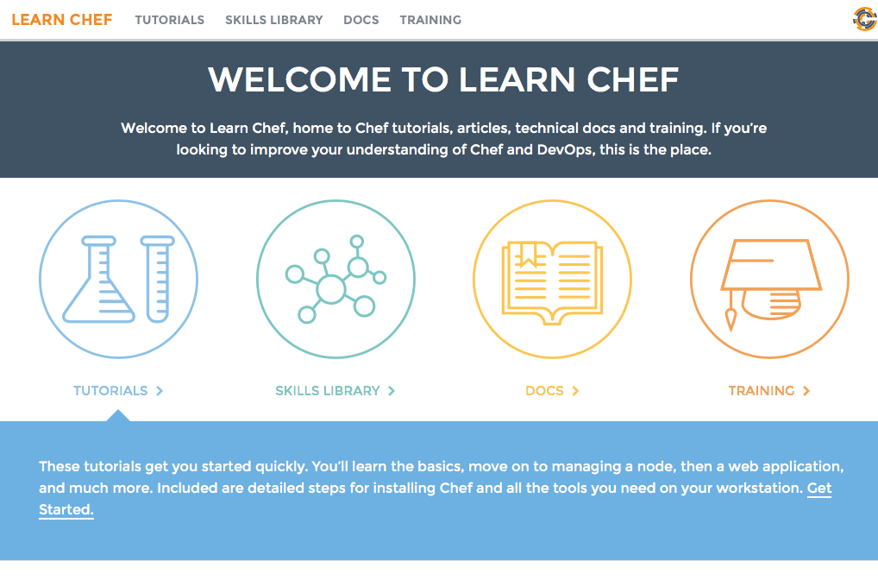
Learn Chef is for:
Evaluators
Those who are new to a team that uses Chef
Those who wish to extend their skills
https://learn.chef.io

Slide 3

Who are you?
Job role
Systems administrator?
Software developer?
Business development?
Configuration management
Chef?
Puppet? Ansible? Salt?
CFEngine?
Homegrown?
Other?
CI/CD
Chef Delivery
Bamboo
Jenkins
Travis
TeamCity
Team Foundation Server

Slide 4

Chef is about automation
Photo: abb.com

Slide 5
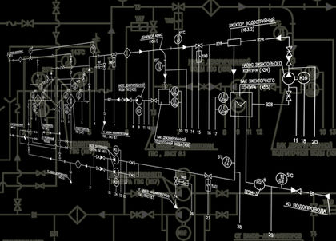
Specifically, Chef is a framework
for automating infrastructure and applications
Photo : www.referenceforbusiness.com

Slide 6


A tale of traditional systems management – meet Bob
Image: cnn.com

Slide 7



How does Bob work?
Bessie
Webbie
Falcon
Chewbacca
Image: cnn.com

Slide 8
How does Bob work?
Bessie
What could possibly go wrong?
Webbie
Falcon
Chewbacca
Image: cnn.com

Slide 9

Systems management involves many things!
Domain knowledge Scale Change management Cost Speed | Confidence Reliability Auditing Security Documentation
Image: remarcom.typepad.com

Slide 10
Give Bob some tools to make his life better!
Automation
Image: cnn.com

Slide 11
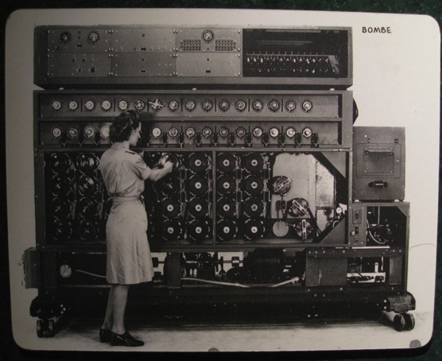
Chef is infrastructure as code
Chef is infrastructure as code
Programmatically provision and configure components
Treat like any other code base
Why is code good?
Image: http://www.flickr.com/photos/louisb/4555295187/

Slide 12
Code is good!
Domain knowledge Scale Change management Cost Speed | Confidence Reliability Auditing Security Documentation
Reconstruct business from code repository, data backup, and compute resources
Image: remarcom.typepad.com

Slide 13
The Chef software platform
Management Console
High Availability and Replication
Analytics
Platform
Chef
Client Nodes
Data Center
Chef Server
Chef Development Kit
The Cloud
Cookbook and Policy Authoring
Test-Driven Infrastructure

Slide 14
Building blocks
Cookbooks
Recipes
Resources

Slide 15
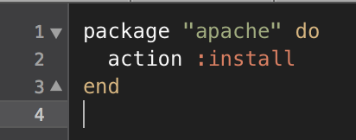
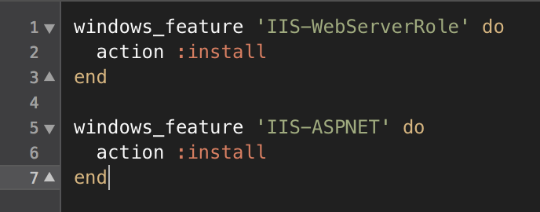
Building blocks: what is a resource?
A resource is a system state you define
Example: Package installed, state of a service, configuration file existing
You declare what state you want the resource in.
Chef automatically determines HOW that state is achieved
On Linux based OSes:
On Windows based OSes:

Slide 16
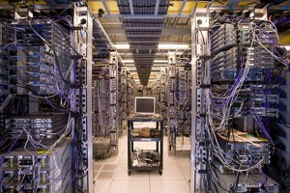
Demo: Configure Apache web server in a local environment
The Chef workflow starts with local development.
We’ll use Test Kitchen to build and verify a basic web server configuration.
What’s needed to bring up a basic Apache configuration?
Image : zoompf.com

Slide 17
Yes!

Slide 18
That’s cool but…
Are we all done?
How do we move our changes to production?
How do we do so safely and at speed?

Slide 19
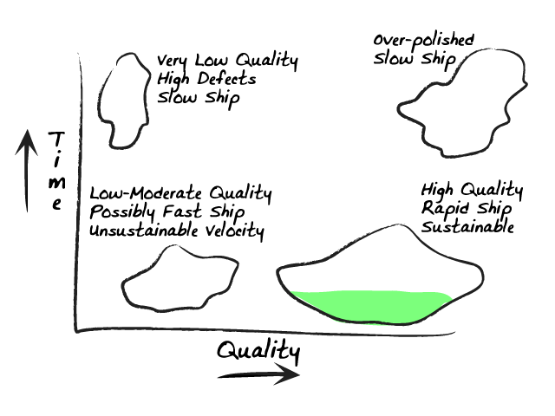
Safety vs. speed
Image: ronjeffries.com

Slide 20
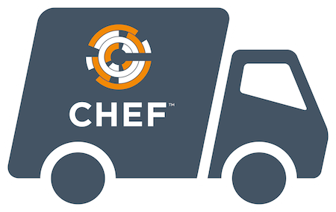
Chef Delivery

Slide 21
Introducing Chef Delivery
Adopt a proven workflow to go more quickly
from idea to shipped software
High velocity with safety
Reliable and repeatable workflow
Visibility of who did what, and when
Notes:
Chef Delivery accelerates adoption of Continuous Delivery and reinforces DevOps best practices
Chef has identified a proven workflow for managing change, validated with enterprise and big web customers.
Every business is a software business. To stay competitive, teams need a reliable and safe way to deliver value to customers as quickly as the business demands.
Delivery provides an automation solution that spans the entire lifecycle of a change, from local dev on a workstation through deployment to production.
Chef’s workflow has been developed based on industry best practices around DevOps, and Delivery promotes adoption of this proven workflow.
How do you reduce risk when continuously deploying change?
Test for quality and compliance as part of the workflow

Slide 22
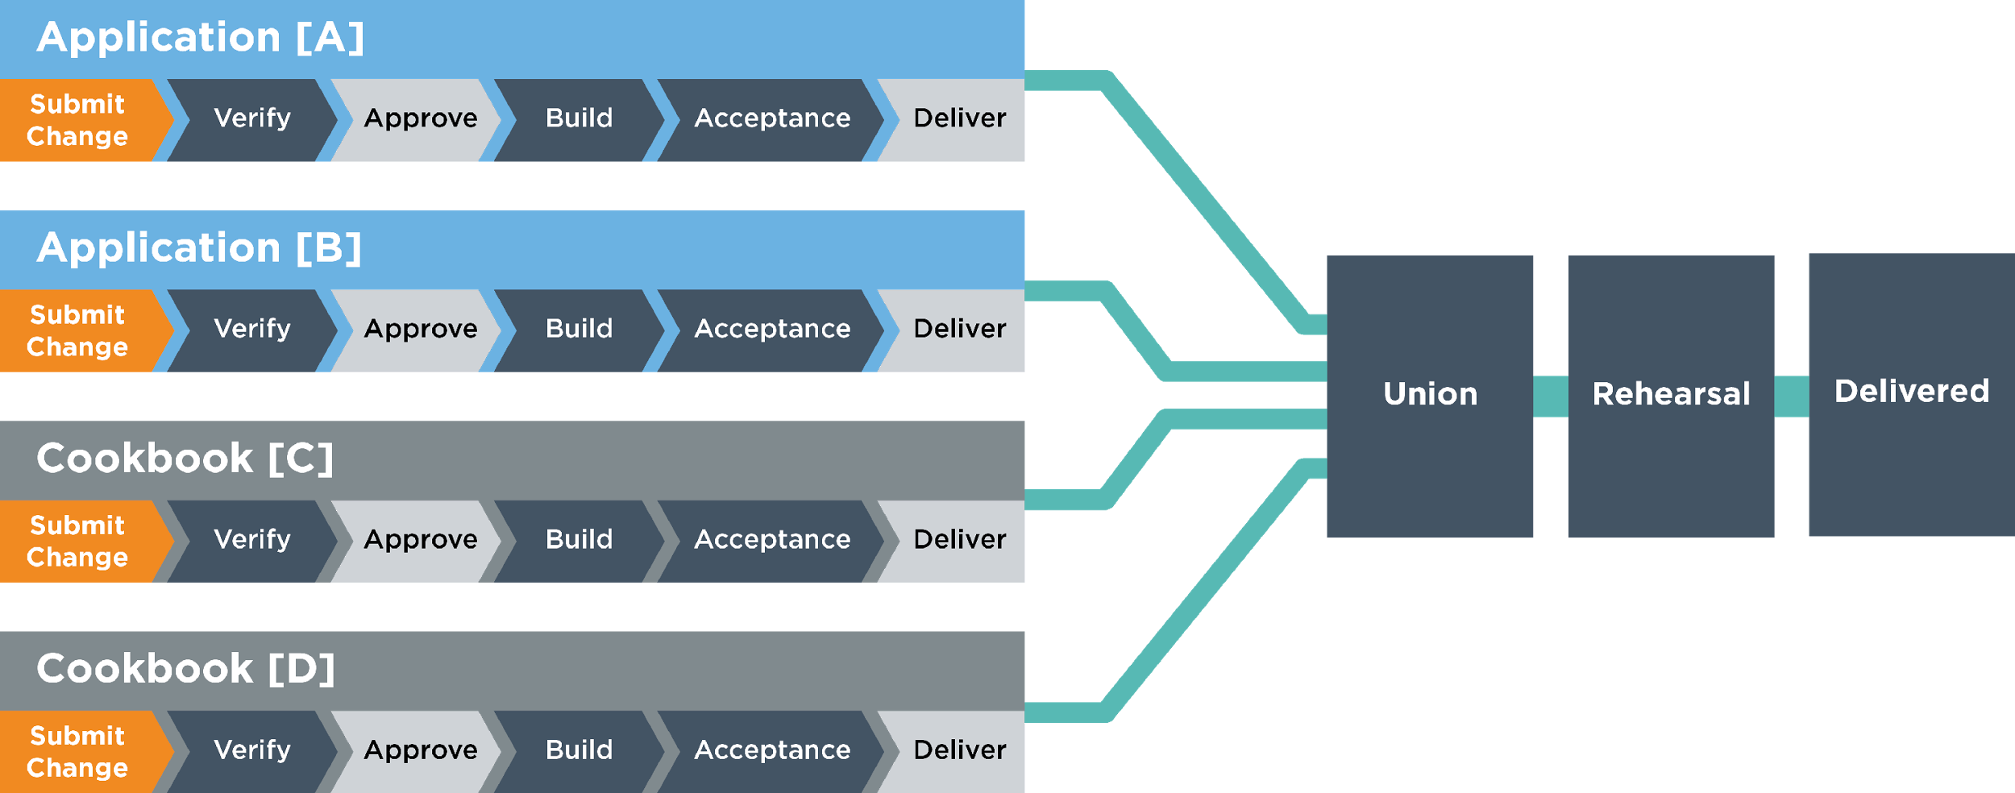
Shared workflow
Delivery’s pipeline is shared across projects and teams
Notes:
Delivery behaves no differently for "infrastructure" code or "application" code. One of our core principles is that code is code, and Union is where all the pieces meet.
- To weave compliance in here, you can talk about using the pipeline to quickly delivery patches needed in an emergency remediation scenario (vulnerability response)
An update for compliance is likely something that should be managed via a cookbook, such as OpenSSL patch to remediate a vulnerability
Each project has its own acceptance pipeline.
The system enforces a single change-at-a-time moving through each of
Union, Rehearsal, and Delivered.
This keeps things stable. If something breaks, you can identify the
change that introduced the breakage, and you know who to pull into
a conversation about how to fix things.
NOTE: the psychology of what are you making a change to? The WHOLE THING. It's a system. Not a project.
This is a good place to talk about why the shared pipeline model promotes safety:
Delivery promotes a “small batch” model, shipping one thing at a time to ensure discovery of integration problems before a change reaches production.
Union is the place where all the pieces meet within a dependency set to ensure the system as a whole is safe. If you are managing 4 projects through your Delivery pipeline and the first 3 have dependencies within each other, we can think of those as a conceptual dependency set within Union. If the fourth project that is not part of that dependency set has a change that needs to go through, it will not get “stuck” behind changes related to the first 3 projects. In this way it is possible for changes to move through the shared pipeline in parallel, where there are not overlaps in their respective dependencies.
Being able to move fast itself adds safety: remediation of defects, vulnerabilities etc. Systems that are easy to fix are safer.
Q. Why did we not choose "QA", "staging" and "production" as the names instead of "union", "rehearsal", and "delivered"? And can I customize the names?
A. The semantics of those words are overloaded and different in each business, so we wanted to start from a clean slate. The names cannot be changed.

Slide 23

Unified Pipeline Shape
The stages are fixed, and each stage has a fixed set of phases
Submit
Change
Does this
code change
look good?
Do we want
to ship this?
VERIFY
BUILD
ACCEPTANCE
UNION
REHEARSAL
DELIVERED
APPROVE
DELIVER
Lint
Lint
Provision
Provision
Provision
Provision
Syntax
Syntax
Deploy
Deploy
Deploy
Deploy
Unit
Unit
Smoke
Smoke
Smoke
Smoke
Security
Functional
Functional
Functional
Functional
Quality
Publish
Notes:
We’ve taken a different approach compared to other solutions in that in Delivery the pipeline has a fixed shape.
Pipelines consist of six fixed stages, each of which is comprised of a fixed set of phases.
It's not that we're trying to be inflexible; change the conversation. The common pipeline is prescriptive because it's based on our collective experience.
The flexibility resides in the way you define what happens in each phase, described in the next two slides.
An example here is you can include compliance in your workflow via the Functional phase to confirm that your organization’s security rules are part of testing a change
Part of the reason this is the right approach is that arguing over the pipeline shape can become a huge delay to adopting CD.
Custom pipelines are more difficult to maintain and keep stable over time.
Delivery includes explicit review and approval gates
This allows you to manage change in a way that is compliant with your business or regulatory requirements

Slide 24
Delivery Phases – Example Java Application
Pre-Artifact
Post-Artifact
Verify and Build
Acceptance, Union, Rehearsal, Delivered
Unit
Lint
Syntax
Provision
Deploy
JUnit
Lint4J
javac
EC2
Chef Provisioning
Load jar in Tomcat
Build
Smoke
Functional
Security
Quality
Publish
Fortify
FindBugs
Maven
Artifactory
Curl $URL; check for 200 OK
Selenium
Cucumber
Chef InSpec
Notes:
Delivery’s phases are customizable to work with your existing tool chain
This illustrates an example tool set for a Java application

Slide 25
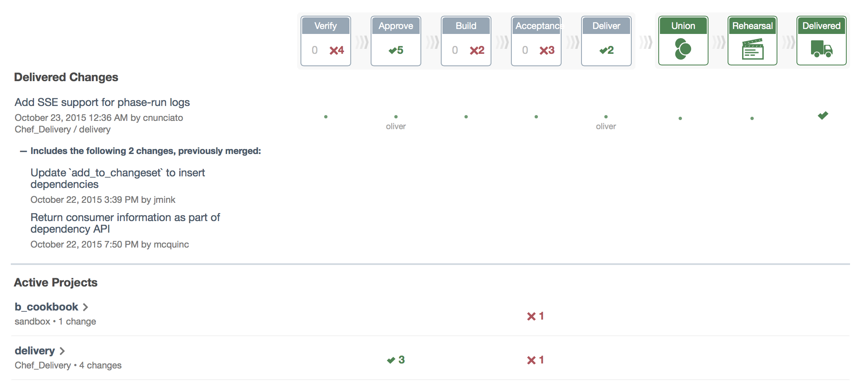
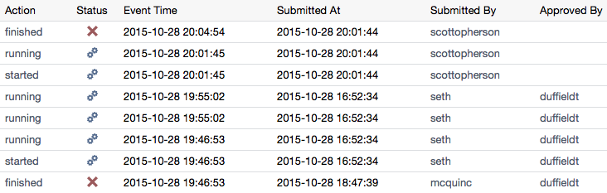
Visualization of Change
Delivery’s dashboard summarizes all changes at a glance
Notes:
Last slide before demo – don’t spend too much time on this, get them to the actual UI
Our dashboard is a differentiator: other CD tools such as Jenkins do not have a robust GUI, visual audit logs, etc.
Delivery enables fast feedback when changes don’t make it through a test phase, allowing you to correct issues before they make it to production
Delivery’s UI provides complete traceability / auditability of a change, from first check-in through production deployment
Including who approved a change and when
Metrics on how long a change takes to move through different stages of the workflow, ability to see which projects have higher rates of change, etc.

Slide 26
Chef Delivery uses Chef to Chef
Each project has a build cookbook
Build cookbooks can also be shared across projects
Delivery project = build cookbook + project config + project code
├── recipes/
├── lint.rb
├── syntax.rb
└── unit.rb
Notes:
This is an optional slide that can be used to further explain the build cookbooks, especially if the audience is new to Chef
Build cookbooks solve another problem that existing CI and CD systems have: how do you version the actual thing that describes how to configure the whole pipeline?
This is sort of meta, but the point is that your pipeline definition is also managed as code

Slide 27
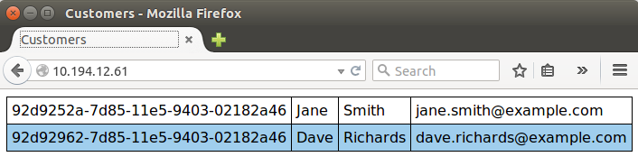
Let’s build a web application!
Customers - an internal web application
Linux (Red Hat Enterprise Linux)
Apache web server
MySQL
Python and JavaScript scripting
The awesome_customers cookbook configures the Customers web application
We’ll use the delivery-truck cookbook as a basis for our build cookbook

Slide 28
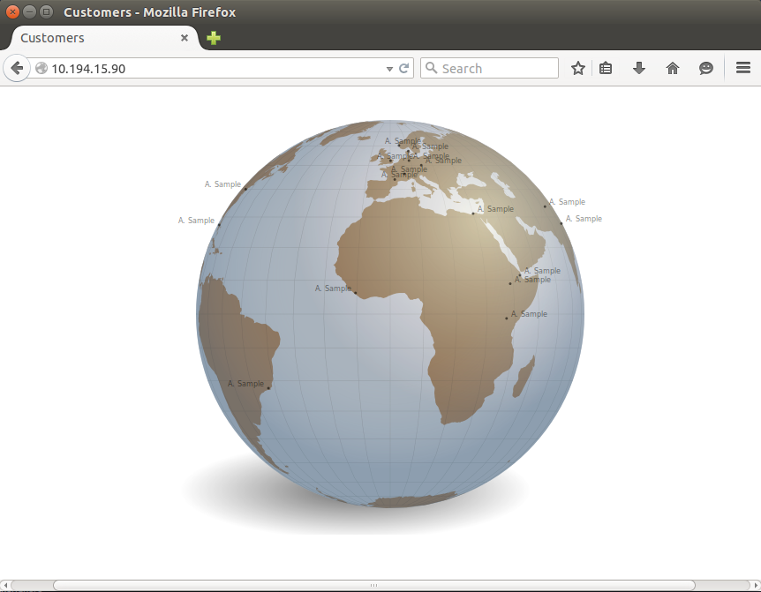
Let’s build a web application! (cont.)

Slide 29
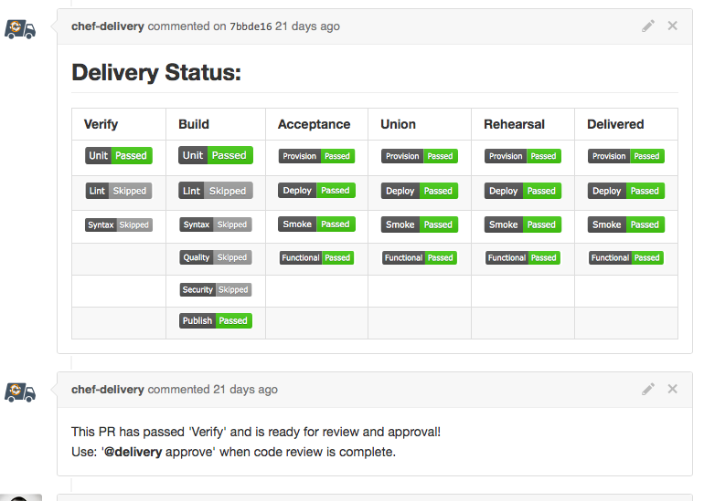
Delivery works with GitHub too! (demo as time allows)

Slide 30
Learn more
Web:
www.chef.io
learn.chef.io
Twitter:
@chef
@learnchef
#cheffriends

Slide 31
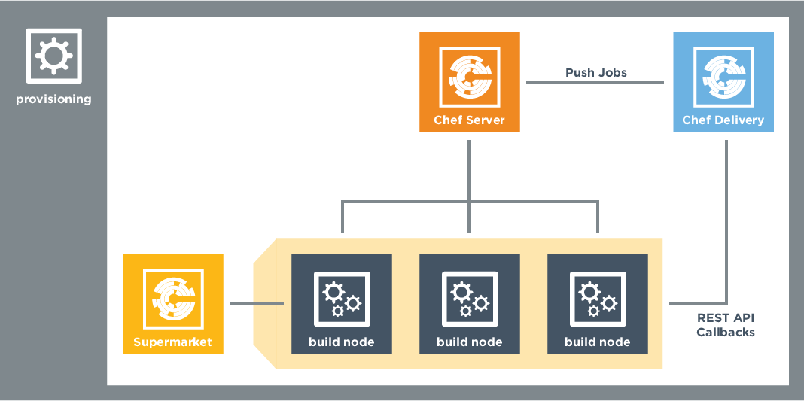
Architecture
Notes:
This is an optional slide. Go into it if you have an audience that is interested in the architecture/topology for Delivery.
Supermarket (internally hosted) is an integral component for managing cookbooks with Delivery, but would not apply if doing apps only
The provisioning node is set up during initial install and is where delivery-cluster runs from (uses Chef Provisioning)
Build nodes may be Windows (WS2012R2) or Linux; Delivery Server only supports Linux

Slide 32
Deploy Automation
Delivery
MyApp
RUN DEPLOY PHASE OF DELIVERED STAGE FOR MYAPP PROJECT
Delivered
API CALL
SSH
TRIGGER CHEF-CLIENT VIA PUSH
Build Node
TRIGGER DEPLOY
ON SELECTED INFRA
deploy.rb
Notes:
Delivery runs the deploy phase – this phase is a part of Acceptance, Union, Rehearsal, and Delivered.
The delivery server selects a build node and dispatches the deploy phase job to it.
The build node fetches the appropriate build cookbook and runs the deploy.rb recipe in a local chef-client run.
The deploy recipe triggers deploys by selecting the target infrastructure and initiating the deploy.
Deploys can be triggered by a push job to run chef client, direct ssh access or an API call.

